Slide 1

Session 2018- 2019 Department of Mechanical Engineering UNIVERSITY POLYTECHNIC GLA UNIVERSITY, MATHURA
Summer Training Report
On
“Arc welded pipe joint”
Name of Student:-keshav dev
Name of Company:-Jindal saw LTD

Slide 2
Product name with brief description along with picture
Seamless Tubes and Pipes
Jindal Saw Limited
Product Description
We are one step ahead from our competitors indulged in making and supplying huge range of Seamless Tubes and Pipes from Kosi Kalan, Uttar Pradesh, India. This division manufactures and markets Seamless Pipes & Tubes. The Pipes are mainly used in Petroleum, Exploration, General Engineering, Power and Automotive. Seamless division has till date manufactured and supplied approx. 1 Million MT of Pipe across the globe. Besides having strong market presence in India, this division has supplied pipes to Middle East, North America, Latin America, Europe, Asia, CIS and Africa.

Slide 3
Seamless Tubes and Pipes
Country:
India
Brand Name:
Jindal Saw Limited
Product Description
We are one step ahead from our competitors indulged in making and supplying huge range of Seamless Tubes and Pipes from Kosi Kalan, Uttar Pradesh, India. This division manufactures and markets Seamless Pipes & Tubes. The Pipes are mainly used in Petroleum, Exploration, General Engineering, Power and Automotive. Seamless division has till date manufactured and supplied approx. 1 Million MT of Pipe across the globe. Besides having strong market presence in India, this division has supplied pipes to Middle East, North America, Latin America, Europe, Asia, CIS and Africa.

Slide 4
Introduction of industry
We are making and supplying huge range of SAW Pipes from Kosi Kalan, Uttar Pradesh, India. We are the market leader capacity wise in manufacturing of large diameter submerged Arc Welded (SAW) Pipes using U-O-E, J-C-O and Helical Processes. The SAW Pipes are mainly used in transportation of Oil, Gas, Slurry and Water. Available in diverse types and qualities. Additionally, these can be availed from us at market leading price

Slide 5
Different products in jindal saw limited
Products of the company:
Large diameter pipes –
• Line pipes • Anti–corrosion coatings • Conversion casings • Hot–pulled induction bends
Ductile iron (DI) pipes –
• Seamless tubes

Slide 6
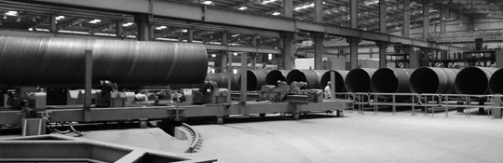
This product to manucturing in jindal saw limited

Slide 7
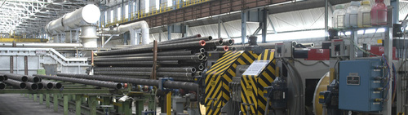
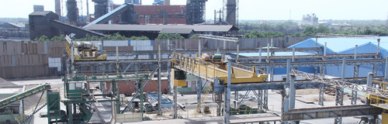
Full discription product with picture

Slide 8
Introduction of industry
We are making and supplying huge range of SAW Pipes from Kosi Kalan, Uttar Pradesh, India. We are the market leader capacity wise in manufacturing of large diameter submerged Arc Welded (SAW) Pipes using U-O-E, J-C-O and Helical Processes. The SAW Pipes are mainly used in transportation of Oil, Gas, Slurry and Water. Available in diverse types and qualities. Additionally, these can be availed from us at market leading price

Slide 9
Company with full address
Jindal Saw Limited
Plot No. A-1, Nandgaon Road, Upsidc Industrial Area, Mathura,, Kosi Kalan, Uttar Pradesh, 281403, India

Slide 10
Nature of besinuss of the industry
At the company, the business operations are highly structured with three strategic business units: large diameter pipes, seamless tubes, and DI (ductile iron) pipes. Every SBU has its own dedicated sales and marketing targets and operations.
In 2006, Jindal SAW realigned itself by disposing off non–core business in the US and focused its energies on the Indian growth story by launching several new initiatives.
The company has consistently created value by creating low–cost capacities in capital–intensive industries in businesses largely overlooked by other corporate. Jindal SAW has recently launched its Jindal ITF (infrastructure, transportation, fabrication) subsidiary

Slide 11
This company is steel industry
This company to manufacturing the mild steel to jainted
The ms coils to manufacturing to produced the pipes
This companyis steel company

Slide 12
The name of deparetment in company
I am compaleted to my summar traning in jiandal saw lmt
My department of manufacturing

Slide 13
Datials about used machine in company
Focusing on the quality of the product and consumers satisfaction, Master Exports is a leading SHEARING MACHINE SUPPLIED firm, possessing an enormous number of clients across the world. The Master Exports Ludhiana has an experience of over 40 years of manufacturing, supplying and exporting machine tools. The well-known Shearing Machine suppliers and exporters have the head office located in Ludhiana, Punjab. Master Exports have also supplied to the various government as well as Indian private Technical Institutes and Engineering Colleges

Slide 14
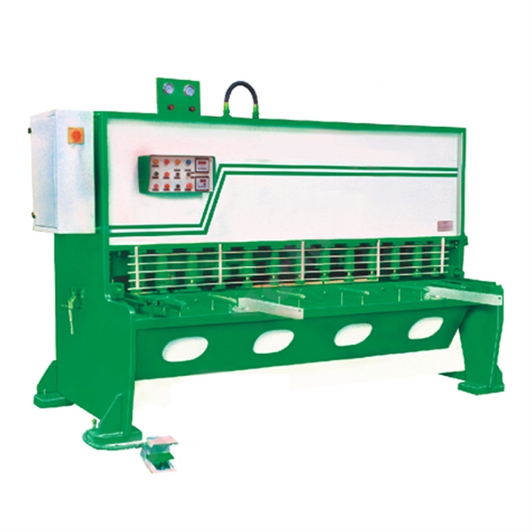
SHEARING MACHIN IN USE OF JINDAL SAW

Slide 15
Industrial training
6 Weeks Industrial Training
FlagBits Technologies offer 6 Week Summer Training for diploma polytechnic Students.We provide a platform to learn about Latest Technologies.After completion of training students are awarded by certificate. For Details of material . Flagbits Technologies offering short term courses for the candidates who want to achieve their goal in short time or who doesn’t have enough time for industrial training . We provide technical knowledge by which they can get reputed job in a reputed company in the field they are interested . Flagbits teaches the professional point to point which they really need .

Slide 16
AGE MILLER
Brief introduction :
This machine comes with top quality components from the world, such as
HSD spindle, Sweden Vomade gear reducer , Germany helical racks etc., and could run very stable at 25m/min.

Slide 17
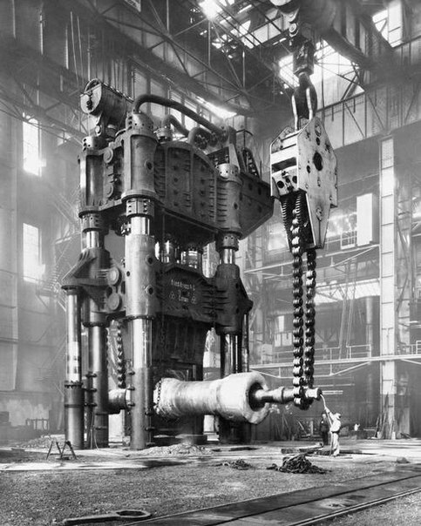
PICTURE OF AGE MILLER

Slide 18
DATAIL ABOUT MACHINE YOUR WORK
The Machine Age is an era that includes the early 20th century, sometimes also including the late 19th century. An approximate dating would be about 1880 to 1945. Considered to be at a peak in the time between the first and second world wars, it forms a late part of the Second Industrial Revolution. By the mid to late 1940s, the atom bomb the first computers and the transistor came into being,^{[6]} beginning the contemporary era of Digital Revolution and thus ending the intellectual model of the machine age founded in the mechanical and heralding a new more complex model of high technology. The digital era has been called the Second Machine Age,with its increased

Slide 19
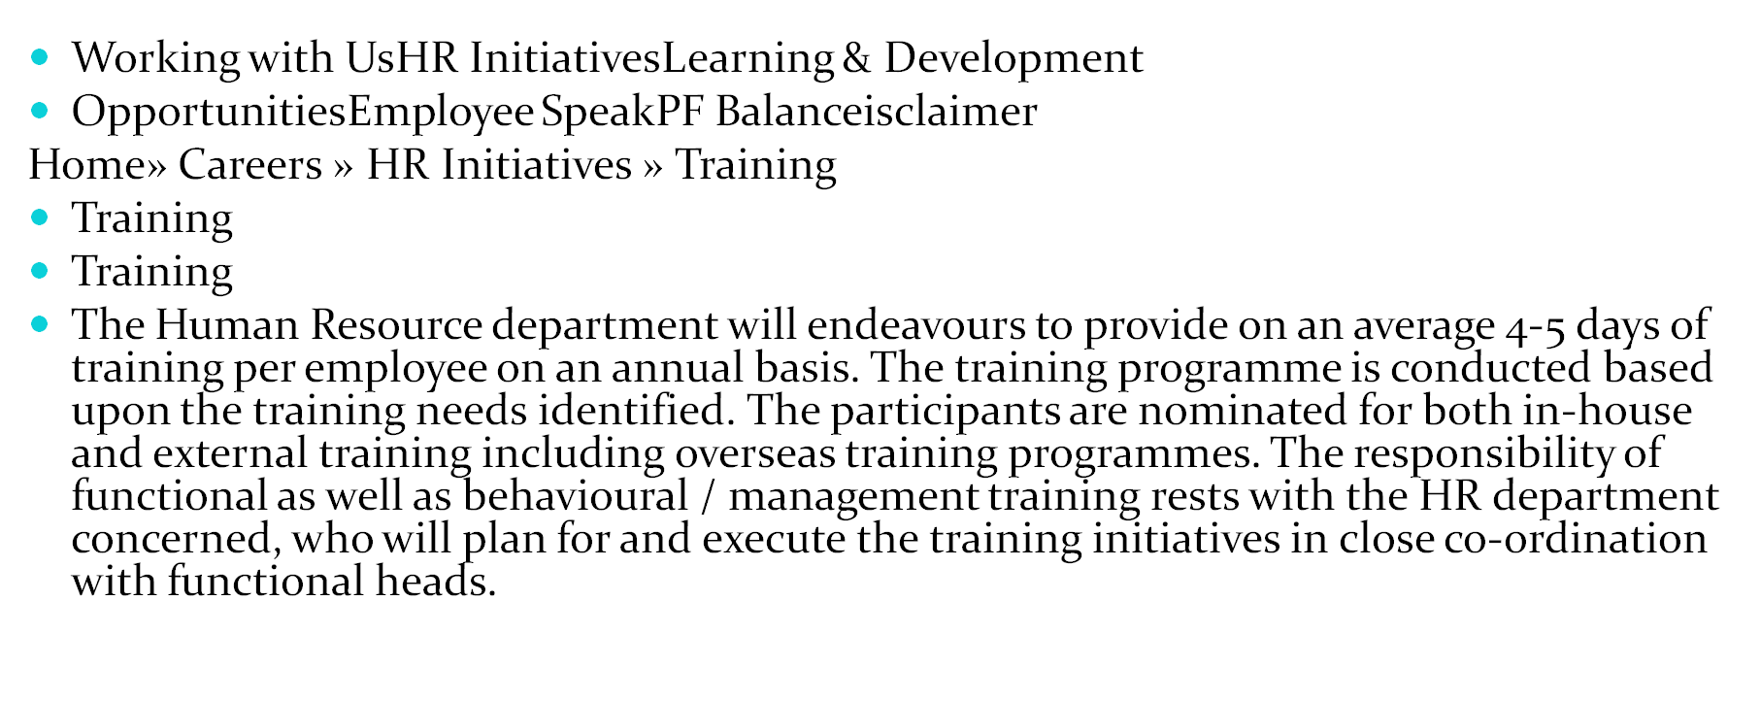
WHAT I LEARNED FROM INDUSTRIL TRAININIG

Slide 20
Thank you

